Slide 1
Denial of Service (DoS) Attacks
A CYBER PROJECT REVIEW II REPORT
Submitted by Raghav Dabra(19BCE2269) Shaurya Kohli (19BCE2268) Saransh Dabas (19BCE0966) CSE 4003 Cyber Security, Fall Semester 2020-21

Slide 2
Table Of Contents
.
.
Executive Summary 3
The Team and Contents of Report 4
Core Concepts 5
DoS Attack Simulation: Step by Step “How To” 13
DoS Attack Simulation: Evidence , Results, and Conclusion 16
Appendix: References 32

Slide 3
INTRODUCTION
The denial of service (DoS) and distributed denial of service (DDoS) attacks are some of the most commonly used network intrusion attacks which, after obtaining the victim's IP address, render the victim's machine, website, network servers, internet network, and/or other network resources unresponsive/unavailable to its intended users by causing the targeted network/server to consume enough of its resources/bandwidth.
The difference between DoS/DDoS attacks are that “DoS attacks are executed through a single system/Internet connection while DDoS attacks are distributed and are executed through multiple systems/Internet connections” (Bryson 5).

Slide 4
A denial of service attack can also last for extended periods of time and usually depends on how much network packet/request flooding the attacker is pushing to the victim.
Furthermore, with DoS/DDoS attacks, the victim’s network is typically flooded with packets (TCP, SYN, and/or UDP packets through the network layer (layers 3/4)) or with
Under a denial of service attack, the victim will not be able to use their network services which ultimately causes many problems for the victim as the modern world now revolves around the Internet and its networks.

Slide 5
DoS Simulation (SYN Flood)

Slide 6
With this project, we have simulated a denial of service (DoS) attack through the development/use of an open-source DoS TCP SYN packet flood Python script prototype that will be running on the attacker’s computer, using Python3 on the Kali Linux OS (VM) which is installed on VirtualBox, to simulate a DoS attack on a targeted network and render the target network unresponsive.
Furthermore, this Python script, called TCP SYN Packet Flood, floods the target network with SYN packets through the network layer (layers 3/4) through the TCP protocol and port 80 in order to render the target network/server unresponsive by forcing the network/server to consume enough of its resources/bandwidth and leaving a large number of connections half-open.
Our denial of service attack is local based as it will executed through the attacker’s (host user’s) network, who can then, using the Python script against a targeted website/network which is run on a cloned Kali Linux virtual machine that is run on the same network and subnet as the other Kali Linux virtual machine being used to initiate the DoS attack with the Python DoS script (with both virtual machines being located on the attacker’s (host’s) single system), send various requests and bots to flood the targeted website/network, or the attacking system’s own network, through its port(s) (mainly port 80) with SYN packets.

Slide 7
Findings
During our project, we discovered that our DoS attack simulation was successful against the targeted website/network we tested it on a website http://www.hackertyper.com which converts text into random programming code words and is run on an Apache /Nginx based web server. As a result, throughout our DoS attack simulation, we managed to find information about the strength of the victim's network security as well as the information about the targeted network itself
Examples of our main findings throughout our DoS simulation was that we were able to find the target's IP address, render hackertyper.com locally unresponsive through SYN packet flooding, determine the security level of the target's network from the DoS attack, and find that our DoS attack forcefully caused hackertyper.com’s network server to become unresponsive on the local network our DoS simulation was conducted on due to the nature of the DoS attack.

Slide 8
The Team and Contents of Report

Slide 9
The Team
The DoS attack simulation team consists of Raghav Dabra , Shaurya Kohli and Saransh Dabas. Our team members have worked together in the development of running a DoS Python script prototype, using Python3 programming on Kali Linux installed on VirtualBox.
This Python script will simulate a DoS attack on the targeted network. The goal of the DoS script is to ultimately render the targeted network’s services unresponsive by flooding the network with SYN packets. Furthermore, the Python DoS script can also be used by being run in multiple instances on multiple computing systems to further exhaust the target network’s resources.

Slide 10
Contents Of Report
Within this report, there are multiple sections which consist of an executive summary of the overall report, describing the core concept(s) of DoS/DDoS attacks, a step by step "How To" of how to simulate a DoS attack, results/evidence collected from simulating our own DoS attack on a network, and the references we utilized which helped us write the overall report and develop our DoS attack simulation prototype.
In the “Core Concepts” section, we dive into the core concepts/technical details of DoS/DDoS attacks and thoroughly describe how DoS and DDoS attacks work/their differences, why an attacker may perform a denial of service attack, the consequences denial of service attacks can have for its affected victims, and how denial of service attacks can be prevented.
We will also describe the technical details of how TCP SYN packet floods work along with IP Spoofing TCP SYN in the next review.

Slide 11
In the "Step by Step How To" section, we describe how we simulated our own DoS attack on a network step by step. We also go into details of how to develop/run our prototype of the DoS Python script file against a network after obtaining the victim's IP address and then flooding the victim's network with SYN packets. This python script can also often be utilized through running multiple instances of the Python script on multiple computing systems to further put stress on the target network.
In the “Evidence, Results, and Conclusion” section, we show the evidence (via screenshots) that we collected from simulating our own DoS attack on a network through using two Kali Linux virtual machines installed on VirtualBox (one of which was cloned) and using a Python script through Python3 Programming to flood the target network with SYN packets. We also show and describe the results of what our DoS attack had accomplished on the targeted network, what information we found from our simulated DoS attack, what information we learned from DoS/DDoS attacks in general, and write-up the conclusion of our project.

Slide 12
Lastly, in the “References” section, we list the sources we have used which have helped us write our overall report on DoS/DDoS attacks. These references were also used to help us develop our DoS attack prototype.

Slide 13
Core Concepts

Slide 14
The main core concept of a DoS/DDoS attack is to render a targeted network unresponsive by flooding the target network, often with packets, in order to cause the targeted network to consume enough of its resources/bandwidth so that the target network is ultimately made unavailable/unresponsive to its intended users.
An attacker may be motivated to perform a DoS/DDoS attack as a means of revenge, or for competition, politics, war, cloaking , etc. DoS/DDoS attacks are often commonly used to flood the targeted network's servers, websites, or other network resources.
Denial of service attacks also have various consequences for the victim, such as shutting down the victim's entire network and preventing the victim from gaining access to the Internet, often for long periods of time. DoS/DDoS attacks commonly target the network layer (layers 3/4) or the application layer (layer 7).

Slide 15
In the network layer (layers 3/4), the layer is typically flooded with packets (TCP, SYN, and/or UDP packets) during a denial of service attack. In the application layer, the layer is typically flooded with requests (HTTP, GET, and/or POST requests) during a denial of service attack.
DoS/DDoS attacks can also last for extended periods of time and usually depends on how much network packet/request flooding the attacker is pushing to the victim as well as how long the attacker decides to keep the victim flooded.
A DoS attack, short for denial of service attack, refers to a denial of service attack that is coming from one source, often a single IP address and computing system, and results in flooding a target network in order to overload the network by making the network consume enough of its bandwidth/resources to render itself unresponsive, preventing other users from entering the network.

Slide 16
Since DoS attacks often “originate from a single source, they are much easier to prevent as the source can be pinpointed fairly easily, especially if no IP spoofing is involved” (Bryson 9).
On the other hand, a DDoS attack, short for distributed denial of service attack, refers to a denial of service attack that is distributed, which means that the denial of service attack comes from multiple sources, often various unique IP addresses and computing systems.
DDoS attacks are much more dangerous as they are able to quickly flood and overload a targeted network by rendering the targeted server unresponsive and making the server consume most, if not all, of its bandwidth/resources.
DDoS attacks are also hard to prevent due to the multiple sources a DDoS attack can originate from. In fact, in order to stop a DDoS attack, one must change their IP address or detect and block each unique source that is causing the flooding.

Slide 17
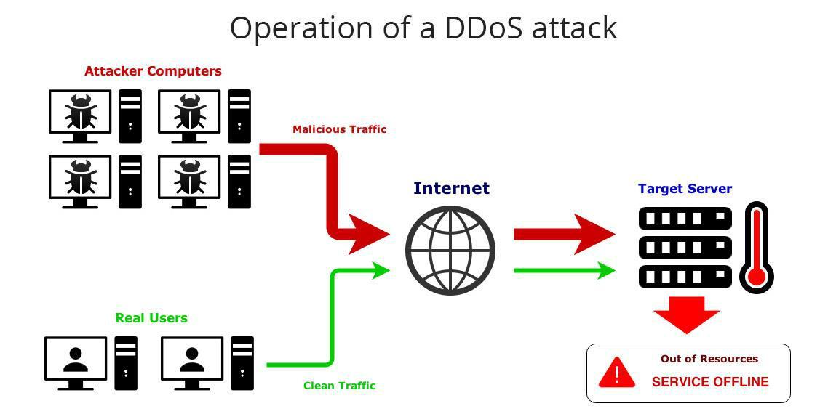
The image below shows a visual representation of how a DDoS attack works (as was described above):

Slide 18
Our DoS attack simulation is essentially a TCP SYN flood DoS attack as it floods the targeted network through the TCP protocol and port 80, the Internet communications protocol of the network/server (HTTP), with SYN packets after the attacker obtains the target's IP address (often IPv4 address).
The target's IP address can often be obtained through the Kali Linux Terminal by pinging the targeted network (if targeting a website), entering “ifconfig” in the Kali Linux Terminal of the target's system (if targeting a network user), or by using other various online resources.
A TCP SYN (transmission control protocol synchronize) flood is a type of DoS/DDoS attack which exploits part of the normal TCP three-way handshake to flood the network server with SYN packers and make the server utilize all of its resources in order to render the targeted network/server unresponsive.

Slide 19
How the TCP three-way handshake works:
Client first requests connection with the server by sending a SYN message to the server.
Server acknowledges the client's request by sending a SYN-ACK (acknowledge) message back to the client.
Client responds to the server with an ACK (acknowledge) message, and this results in the connection being established.

Slide 20
In a synchronized TCP SYN flood attack, the “attacker repeatedly sends SYN packets to every port, or can even target and flood a single port, of the targeted network” (Lee 5).
Since a SYN flood attack works by never responding to the server with the expected “ACK” (acknowledge) code the server is waiting to receive, this results in the server, while continually being flooded with SYN packets, indefinitely waiting for the client’s ACK (acknowledge) message to the server’s SYN-ACK message which was sent back to the client by the server.
As a result, the SYN packet flooding continues to occur and half-open connections remain and are used by the resources on the server. The server will eventually exceed/consume all of its resources, causing the network/server to become unresponsive/unavailable for its intended users.
Overall, SYN flood will normally result in preventing others from entering the network due to the network server being flooded with SYN packets, in which the SYN packets can also often be IP address spoofed, ultimately resulting in the server to indefinitely wait for the client’s acknowledge message (which will never come) and cause the server to consume all of its resources.

Slide 21
In terms of prevention methods, one of the main ways to prevent DoS/DDoS attacks is through IP address spoofing. Since many DoS/DDoS attacks require an initial target IP address in order to conduct the denial of service attack and direct the traffic/flood to, a denial of service attack would not work in the case of a spoofed IP address as IP address spoofing masks one's true IP by creating a false sourced IP address. IP address spoofing can be commonly done through a VPN (virtual private network) or proxy in which a user's network is given a false IP address to mask the true address. Furthermore, another way to help prevent DoS/DDoS attacks is to buy more bandwidth in order to manage and reduce the amount of traffic/load caused by the denial of service attack on the network server. Lastly, since a majority of DoS/DDoS attacks flood through a server's ports, one can keep certain ports in a "closed" state instead of in an "open" state as this will prevent many denial of service programs from accessing and often flooding these ports with network packets

Slide 22
Prerequisites
Command and Control Center:
++++++++++++++++++++++++++
- Softwares to be installed
* nmap - sudo apt-get install nmap
* sshpass - sudo apt-get install sshpass
* hping3 - sudo apt-get install hping3
Bots:
++++
* ssh enabled hosts, present in the same network
* Host must be that system’s administrator
Victim: ++++++
* Web-site hosted on victim’s computer to test DDoS attack. * Web-site site be used to test the attack. For this test

Slide 23
Implementation of TCP SYN FLOODING ATTACK
Resource Depletion attacks:+++++++++++++++++++++++++++
1. TCP SYN flooding attack:
===========================
$sudo python botSearcher.py
----------------------------
This code will look for IP addresses in the local network using nmap tool. To change the network address, edit line 4 of this program.
This tool will save the results in "nmapOP.xml" file.
"botSearcher.py" will then parse this xml file and looks for systems which are up and whose ports are unfiltered and store the IP address of those systems in "IPList.txt" file.
$gcc -pthread botMaker.c
-------------------------
$./a.out
-------- * "botMaker.c" will take the username and password of the bots and will also take the input as name of the python code for implementing this attack. In this case filename is "TCPSyn.py". This attack will be for 60 seconds.
This time value can be changed by changing the value on line 104 in TCPSyn.py file.
To change the victim's IP address edit line 36 of "TCPSyn.py".
To spoof the source IP address edit line 35 of "TCPSyn.py"

Slide 24
Output:
-------
On terminal, login screen of connected hosts will appear. Error messages from unsuccessful connection to hosts will also appear. After the attack, "success" message will be displayed from the all the hosts.
* Can also run wireshark on the victim system to see the packets.
* Can use any browser to load the webpage hosted on victim's system, if attack is successful, the page will take more time to load.
* Can ping to the victim and see the time difference after the attack

Slide 25
How the DoS Attack Simulation Works (SYN Flood)
First, we cloned the Kali Linux virtual machine so that we can have our cloned Kali Linux virtual machine run on the same network (IP address) and subnet as the other Kali Linux virtual machine being used to initiate the DoS attack with the Python DoS script, with both virtual machines being located on the attacker’s (host’s) single system. Then, we tested our attack against the targeted website/network which is run on the cloned Kali Linux virtual machine. , and entering the target’s port number to flood (usually port 80 as it is the port number for the server’s Internet communications protocol (HTTP)) and the packet flood rate (default is 135) and then hitting ENTER, which floods the target network with SYN packets through the network layer (layers 3/4) through port 80 and the TCP protocol
.

Slide 26
From the targeted network being flooded with packets and being left with a large number of connections half-open, our goal was to ultimately render the target network/server locally unresponsive through the targeted network/server using all of its resources and consuming enough of its bandwidth. In our DoS attack simulation, the targeted website/network which was packet flooded and successfully rendered unresponsive with the DoS script was on a cloned Kali Linux virtual machine that was run on the same network (IP address) and subnet as the other Kali Linux virtual machine that was used to initiate the DoS attack with the Python DoS script, with both virtual machines being located on the attacker’s (host’s) single system. Furthermore, the website that was DoS attacked on the cloned virtual machine and rendered locally unresponsive was called

Slide 27
http://www.hackertyper.com (a website which converts text into random programming code words and is run on an Apache/Nginx based web server). To make sure our DoS attack was functioning properly, we also executed a Wireshark capture log on both the attacking Kali Linux VM and the cloned Kali Linux VM while the attacking VM was running the Python DoS script against the target in order to verify that the targeted website/network was being flooded on both the attacking Kali Linux VM and the cloned Kali Linux VM (both VMs were run on the same network (IP address) and subnet).

Slide 28
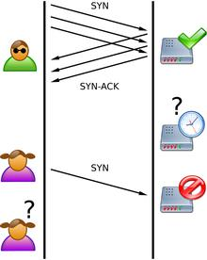
The image below shows a visual representation of how a TCP SYN flood works (as was described above)

Slide 29
Findings (Continued…)
Throughout our project and conducting our DoS attack simulation, we were able to successfully render http://www.hackertyper.com locally unresponsive and obtain information in regards to the strength of the victim's network security as well as obtain information about the targeted network itself. Our main findings throughout our DoS attack simulation included finding the target's IP address, rendering hackertyper.com locally unresponsive, determining the security level of the target's network from the DoS attack, and finding that our DoS attack forcefully caused hackertyper.com’s network server to become unresponsive on the local network our DoS simulation was conducted on. To begin the DoS attack, the first piece of information obtained in our findings was the target's IP address. The IP address of a website can commonly be determined by pinging the website via the Kali Linux Terminal

Slide 30
We also found that our Python DoS script flooded hackertyper.com with SYN packets in order to render the website locally unresponsive and this can be confirmed in the Wireshark capture log files. screenshots found in the “Evidence, Results, and Conclusion” section of the report. We found information on the level of security on the targeted network as well. In this case, it was determined that the target network had low level security due to our simulated DoS attack being successful and our IP address, which was pushing the SYN packet flooding through, not being blocked by the targeted network during the attack. Furthermore, because our DoS attack was successful on the targeted network, we found that we were able to render the victim’s websites, network servers, internet network, and other network resources unresponsive through SYN packet flooding and ultimately exhaust the target network’s resources

Slide 31
We also found that hackertyper.com did not have an HTTPS connection, meaning that the website/network did not have encryption techniques, such as SSL/TLS encryption, for data being exchanged between the client and server, ultimately making it easier to steal sensitive information and/or shut down the network. Lastly, we determined that our DoS attack forcefully caused hackertyper.com’s network server to become unresponsive on the local network our DoS simulation was conducted on due to the nature of the DoS attack and ultimately exposed the network’s weaknesses to SYN packet floods, such as the network’s lack of encryption techniques and inability to block the IP address causing the packet flooding/increased network traffic. Although we did not discover any other information from our own simulated DoS attack, another crucial piece of information an attacker can obtain from a DoS/DDoS attack the shared resources of a website/network.

Slide 32
For example, a DoS/DDoS attacker can discover other websites/networks that the target website/network can be hosting as those hosted websites/networks will also become unresponsive if the target website/network is under a DoS attack. Further detail about our findings can be found within the “Evidence, Results, and Conclusion” section of the report.
Website we were able to successfully DoS attack throughout this project through a cloned Kali Linux virtual machine that was run on the same network (IP address) and subnet as the other Kali Linux virtual machine that was used to initiate the DoS attack with the Python DoS script (with both virtual machines being located on the attacker’s (host’s) single system): http://www.hackertyper.com

Slide 33
From our DoS attack being successful, we also determined that hackertyper.com had low level network security as the website was unable to detect and block the IP address causing the network flooding. Furthermore, hackertyper.com was not secure as it was HTTP (not HTTPS), meaning the website did not have encryption techniques, such as SSL/TLS encryption, to encrypt communication between the client and server.
Throughout the rest of this report, we will go through the detailed step by step of how we conducted our DoS attack simulation against a targeted website/network. We will also provide evidence of our DoS attack simulation being conducted (via screenshots). Lastly, we will describe the results of what our DoS attack accomplished on the targeted website/network.

Slide 34
DoS Attack Simulation: Step by Step “How To”
1.)Download and install VirtualBox from an online source (ex. https://www.virtualbox.org/wiki/Downloads).
2.)Download the Kali Linux OS (.ISO or .OVA format) from an online source (ex. https://www.kali.org/downloads).
3.)Install the Kali Linux OS by mounting the .ISO file or importing the .OVA file throughVirtualBox’s settings.
a.)If .ISO: Open VirtualBox ^{à} Click “Settings” ^{à} Click “Storage” ^{à} Click the mounting disc icon ^{à} Select the .ISO file
b.)If .OVA: Open VirtualBox ^{à} Click “File” ^{à} Click “Import Appliance” ^{à} Select the.OVA file.

Slide 35
4.Clone the virtual machine the Kali Linux OS is installed on. o Right click the Kali Linux VM ^{à} Click “Clone”
5.Launch both the original and cloned virtual machine Kali Linux OS through VirtualBox.
6.Download and install the latest Python3 version inside VirtualBox on the virtual machine OS being used to initiate the DoS attack.
Open the Kali Linux Terminal ^{à} Type “sudo apt-get install python3”
7.Download the provided .ZIP folder containing the TCP SYN Packet Flood Python (.py) DoS script files to the Desktop of the Kali Linux OS VM being used to initiate the DoS attack at https://github.com/cyweb/hammer.
8.)Launch the Python DoS script file (which we named DoSGroupA.py) found in the folder through the Kali Linux Terminal:
Inside the Kali Linux Terminal, type “cd Desktop” ^{à} “cd DoSGroupA” ^{à} “python3 DoSGroupA.py”
9.)Find the IP address of the target by pinging the targeted network through the Kali Linux Terminal (“ping EnterURL”) (if targeting a website), entering “ifconfig” in the Kali Linux Terminal of the target’s system (if targeting a network user), or by using various other online resources.

Slide 36
10.)Follow the on-screen instructions of the DoSGroupA.py file:
o Enter the target’s IP address (“-s ipaddress”), target’s port number to flood (“-p 80”) (default is 80), and packet flood rate (“-t 135”) (default is 135).
11.)Hit ENTER and the script will begin to flood the target’s network with SYN packets.
12.)The targeted website/network will not be able to load or respond since it is being flooded.
o Perform a check by trying to load the targeted website/network and/or viewing the capture log file on Wireshark.
13.)Remember to press Ctrl + C in the Kali Linux Terminal or close the Terminal to stop the DoS attack.

Slide 37
Note: We also found that this Python script can be utilized through running multiple instances of the Python script on multiple computing systems to further put stress on the target website/network. Furthermore, we also found that this Python script does not work against many sites which have an HTTPS connection due to HTTPS’ encryption techniques (ex. SSL/TLS encryption) as well as sites which are not running on Apache/Nginx based web servers.

Slide 38
This attack is really powerful and requires the only skill that you should know how to operate commands on Kali Linux Operating System. First of all, If you want to check that any website has its TCP port 80 opened or not, you can go for nmap, and all the tutorial given for nmap . This tool we are using is Torshammer. It is written in Python and can give damage to unprotected web servers in an instance that’s why it is a slow post tool. Main feature of this tool is it works on the 7th layer of HTTP(Hyper Text Transfer Protocol). Command – git clone https://github.com/dotfighter/torshammer.git
DDoS attack using Torshammer

Slide 39
Any Python tool in Kali Linux should start with “python” suffix and follow by toolname(.)py also. Like that any PHP tool should start with “php” and follow by toolname(.)php. -t is for the target, some domain or ip-address. -p is for port Defaults to 80. -r is for the threads, how many threads we want to run for this attack. -T stands for tor customized attacks. Let’s do the main thing: python torshammer.py <i>any hostname/IP</i> -t -p 80 -r 5000For example- python torshammer.py -t xyz.com -p 80 -r 5000

Slide 40
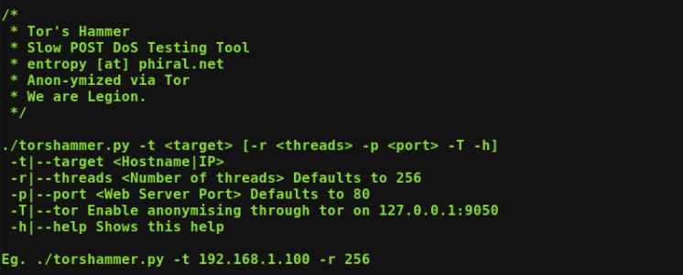
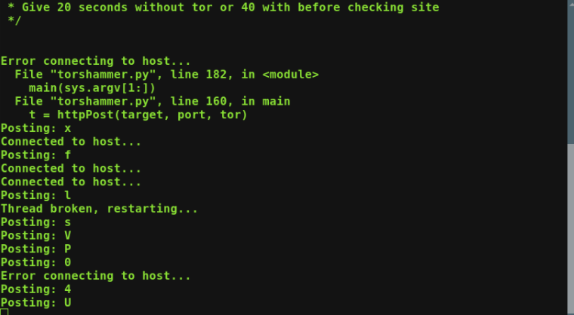
How Hammers Work

Slide 41
After successfully running an attack. If that website is opening normally then they have settled up their website on some Content Delivery Network(CDN) e.g. Akamai, Cloudflare which is designed to work against any kind of DoS or DDoS attacks. For checking that attack is successful or not, you can go to isitdownrightnow.com to verify. "Is It Down Right Now" monitors the status of your favorite web sites and checks whether they are down or not. Check a website status easily by using the below test tool. Just enter the url and a fresh site status test will be performed on the domain name in real time using our online website checker tool. For detailed information, check response time graph and user comments.

Slide 42
Code Part
Headers.txt file (Imported in Hammer.py file)
Accept: text/html,application/xhtml+xml,application/xml;q=0.9,*/*;q=0.8
Accept-Language: en-us,en;q=0.5
Accept-Encoding: gzip,deflate
Accept-Charset: ISO-8859-1,utf-8;q=0.7,*;q=0.7
Keep-Alive: 115
Connection: keep-alive

Slide 43
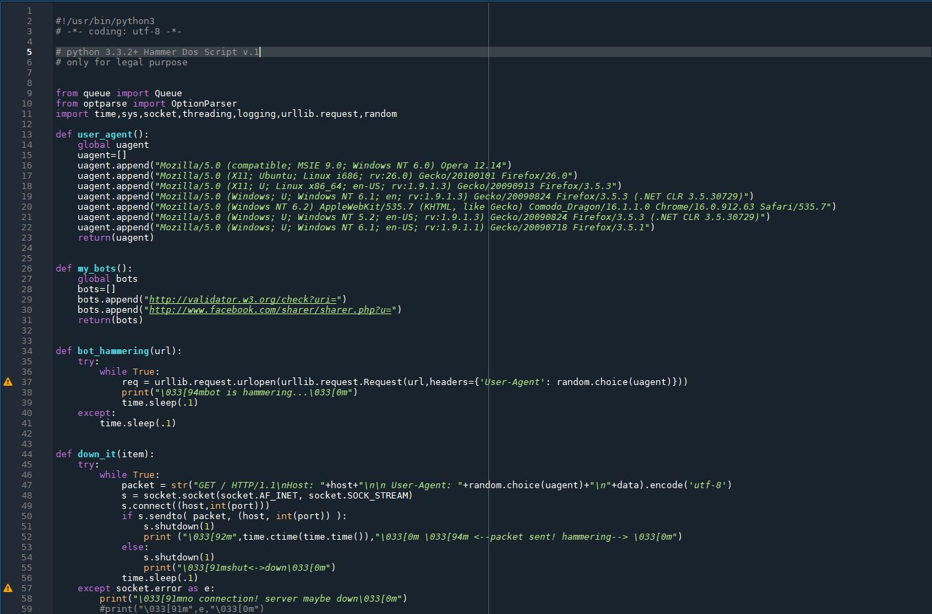

Slide 44
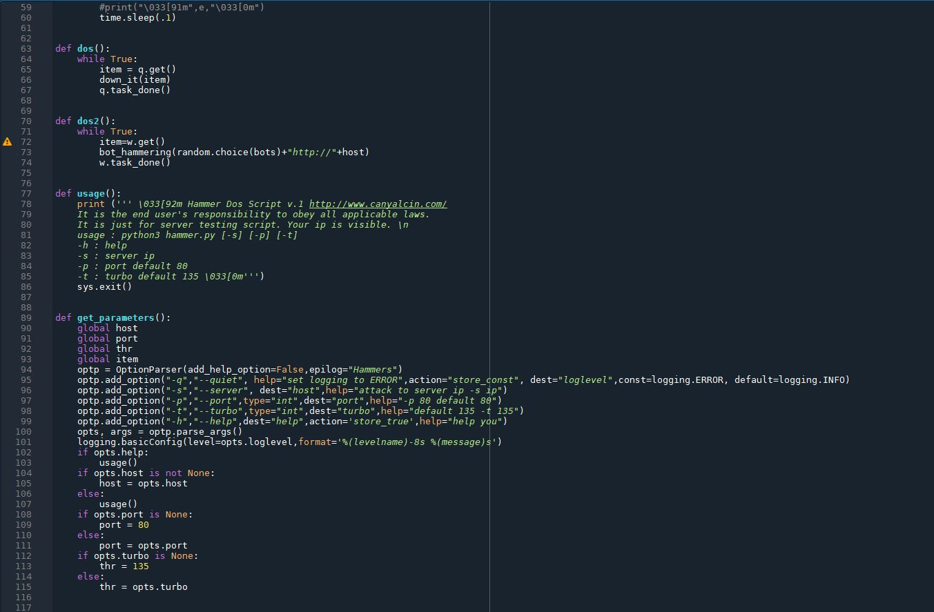

Slide 45
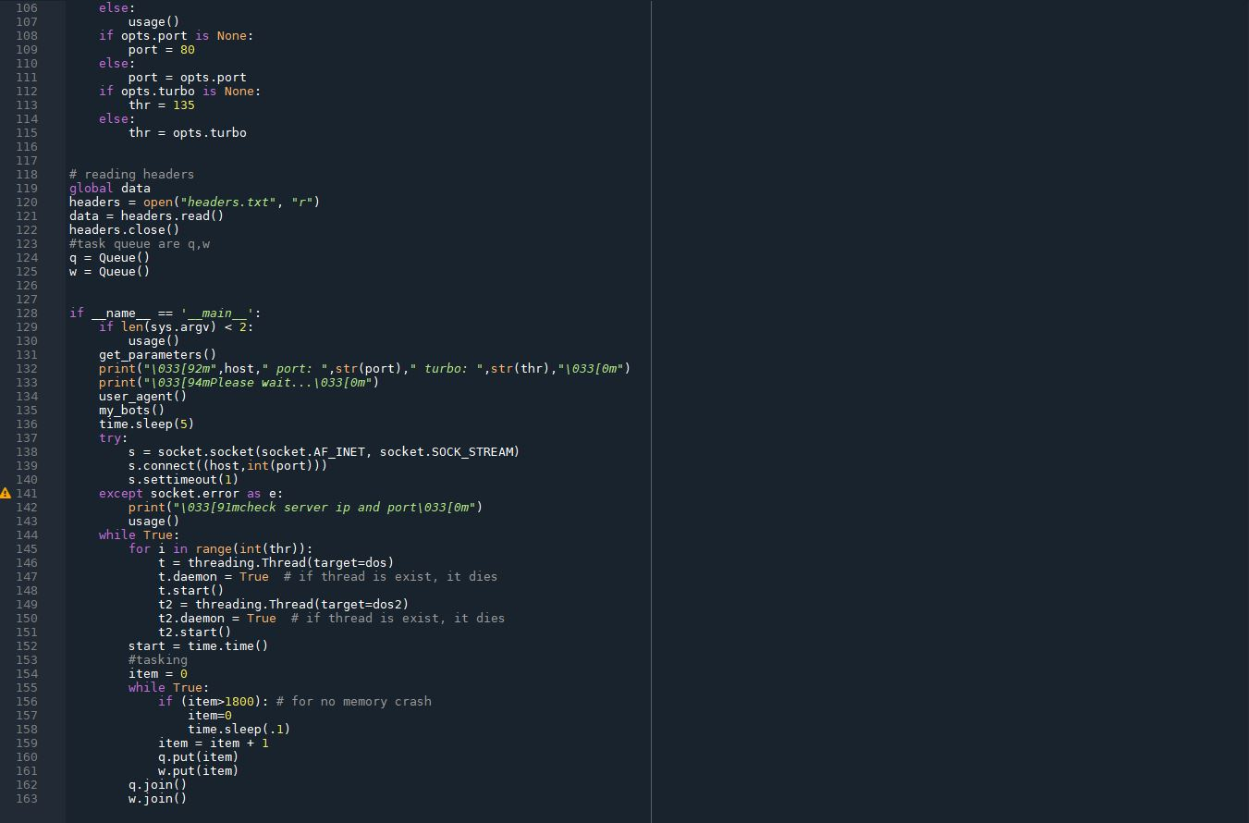

Slide 46
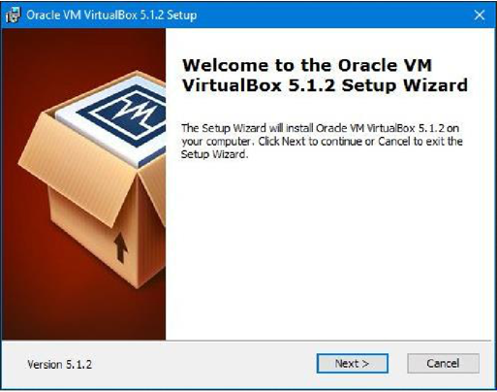
DoS Attack Simulation: Evidence, Results, and Conclusion
Summary of the Screenshots Below: Installing VirtualBox/Kali Linux OS (VM)/cloning the Kali Linux VM and installing Python3 on the attacking Kali Linux VM.

Slide 47
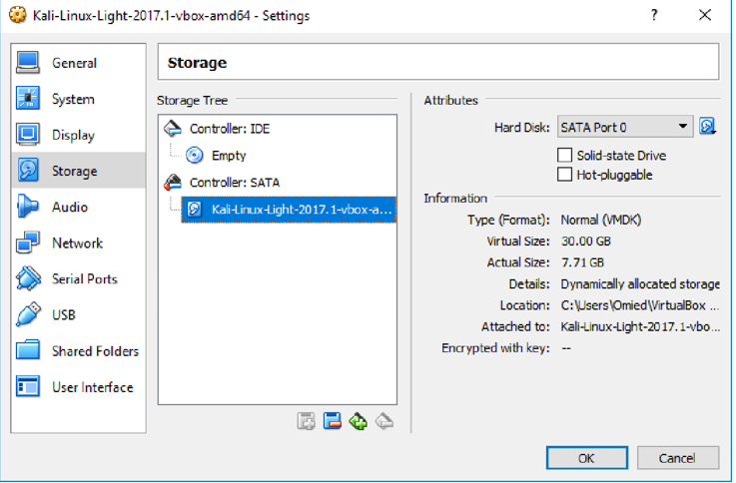

Slide 48
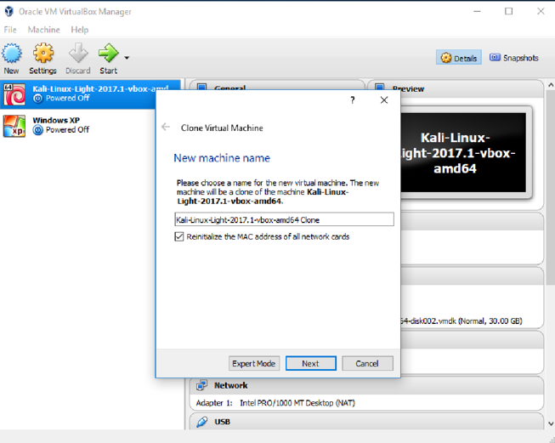

Slide 49
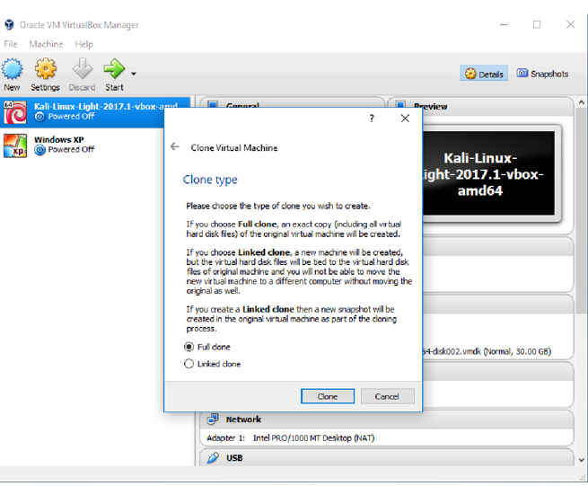

Slide 50
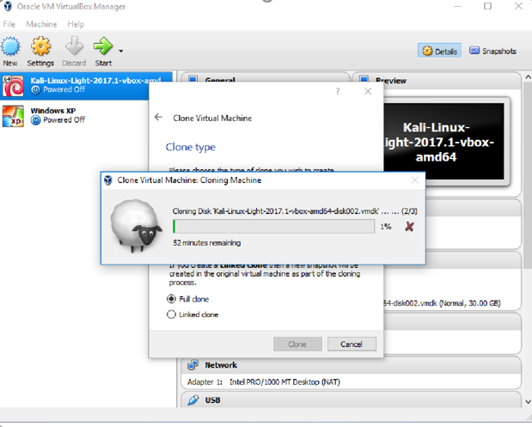

Slide 51
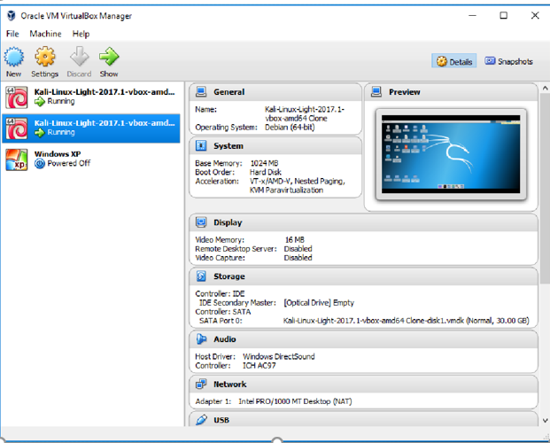

Slide 52
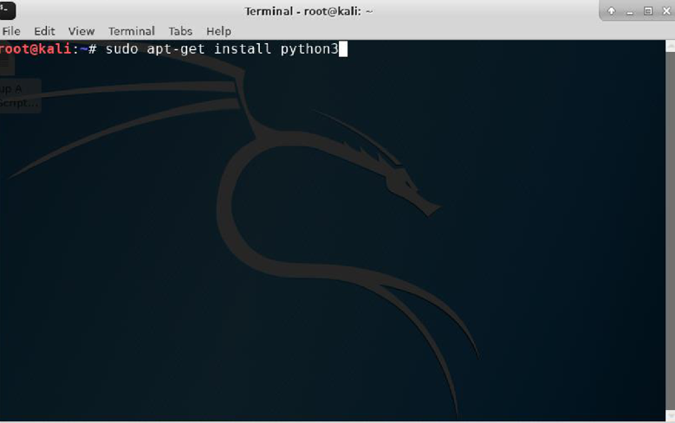

Slide 53
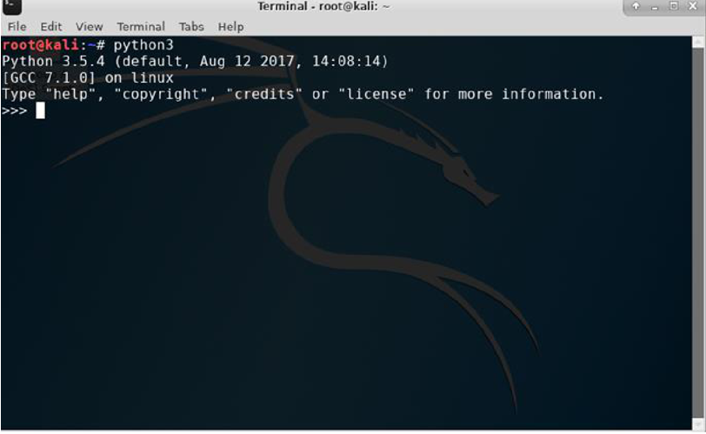

Slide 54
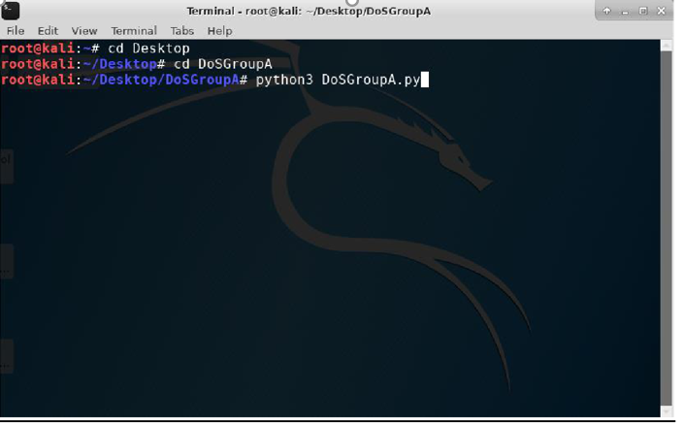
Summary of the Screenshots Below: Opening the Python DoS script on the attacking VM ^{à} Getting the IP address of the target website (http://www.hackertyper.com) ^{à} Python DoS script being used against hackertyper.com (which, in this scenario, the website was running on the cloned VM) ^{à} Stopping the Python DoS script.

Slide 55
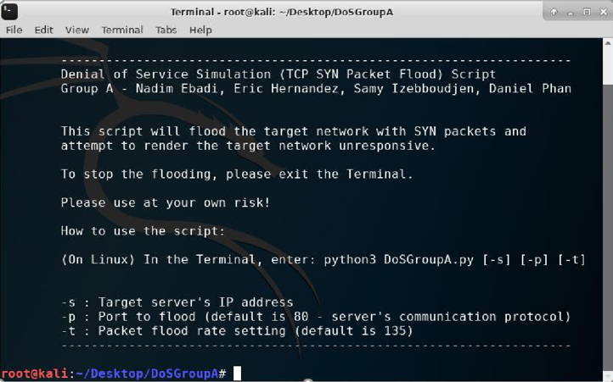

Slide 56
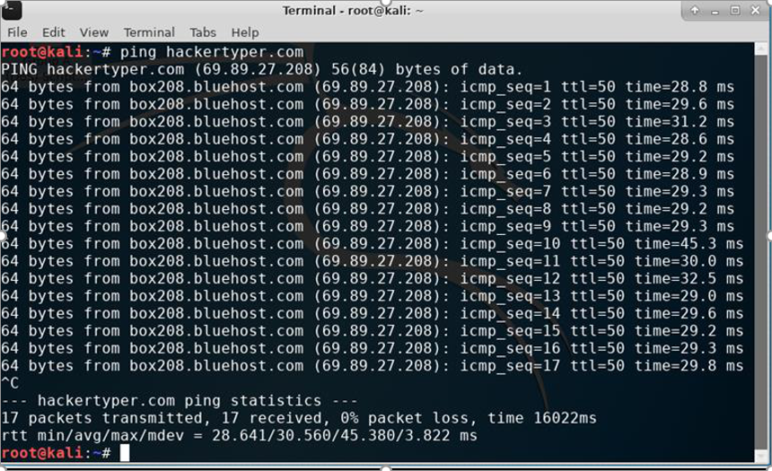

Slide 57
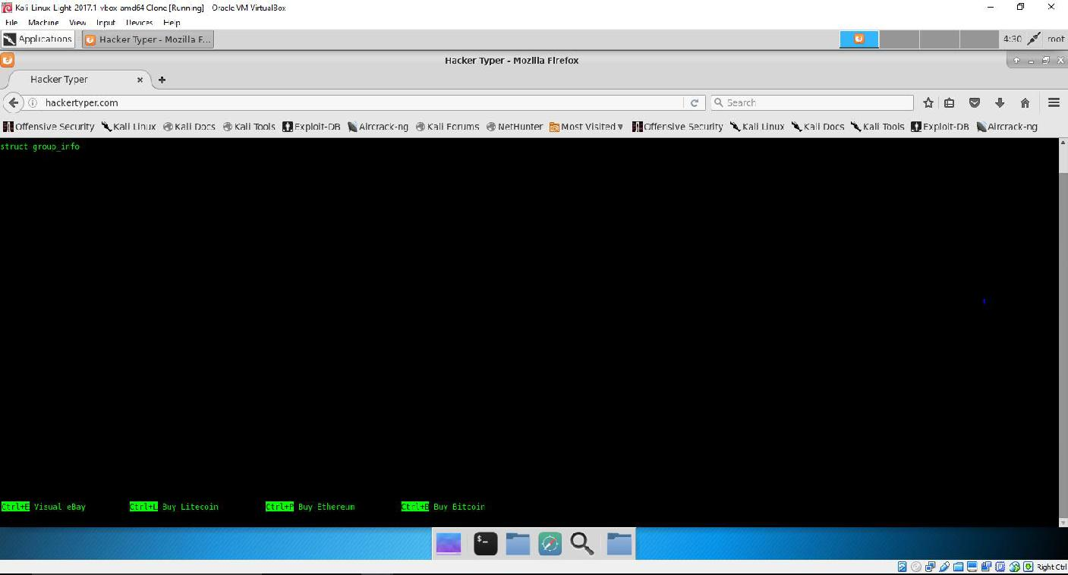
(Please Zoom In) – hackertyper.com running on the cloned Kali Linux VM:

Slide 58
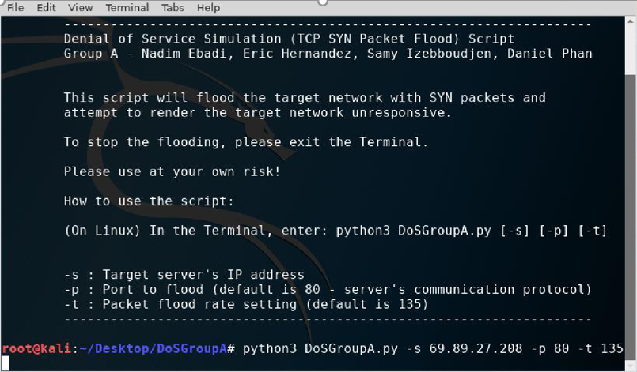

Slide 59
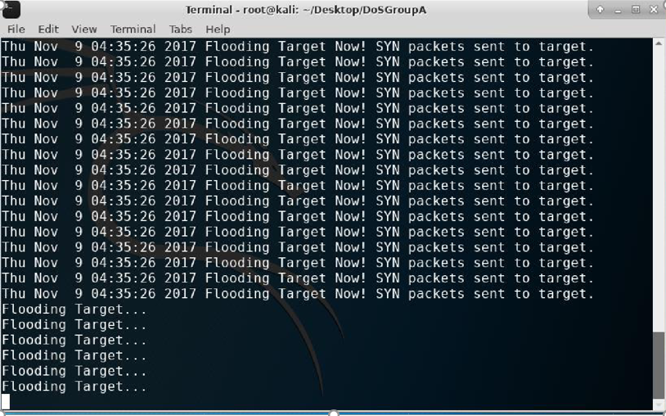

Slide 60
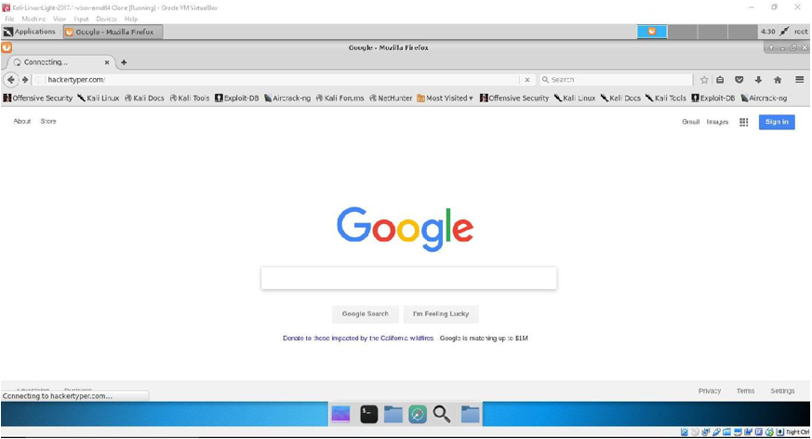
(Please Zoom In) – Now looking back at the cloned Kali Linux VM:

Slide 61
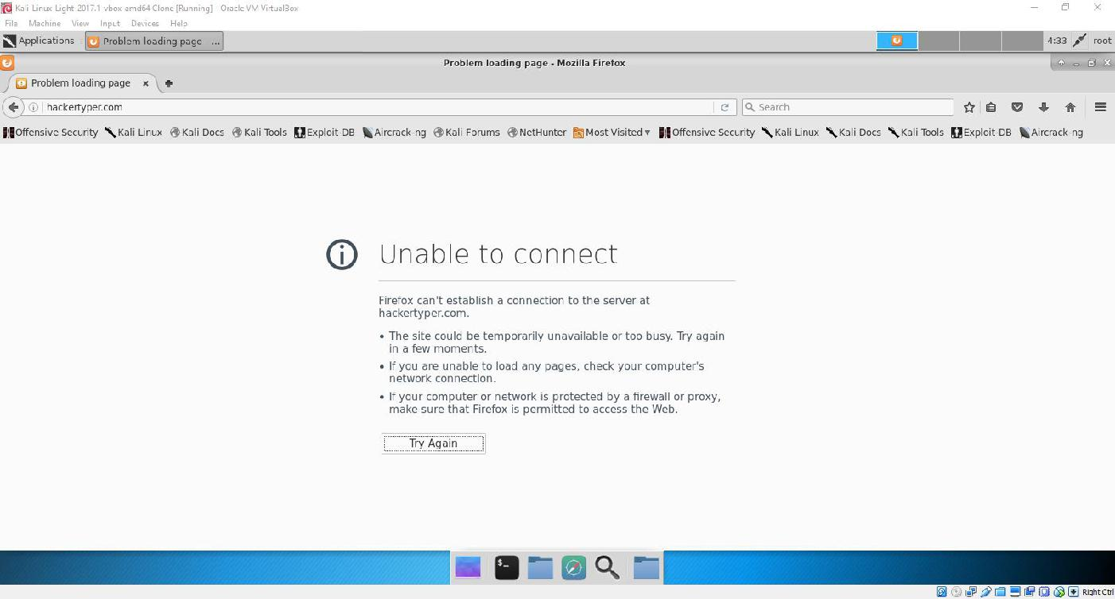

Slide 62
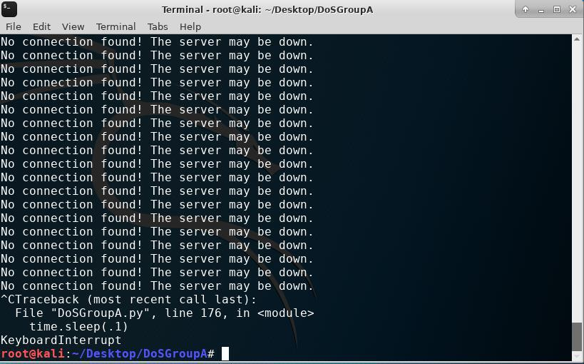

Slide 63
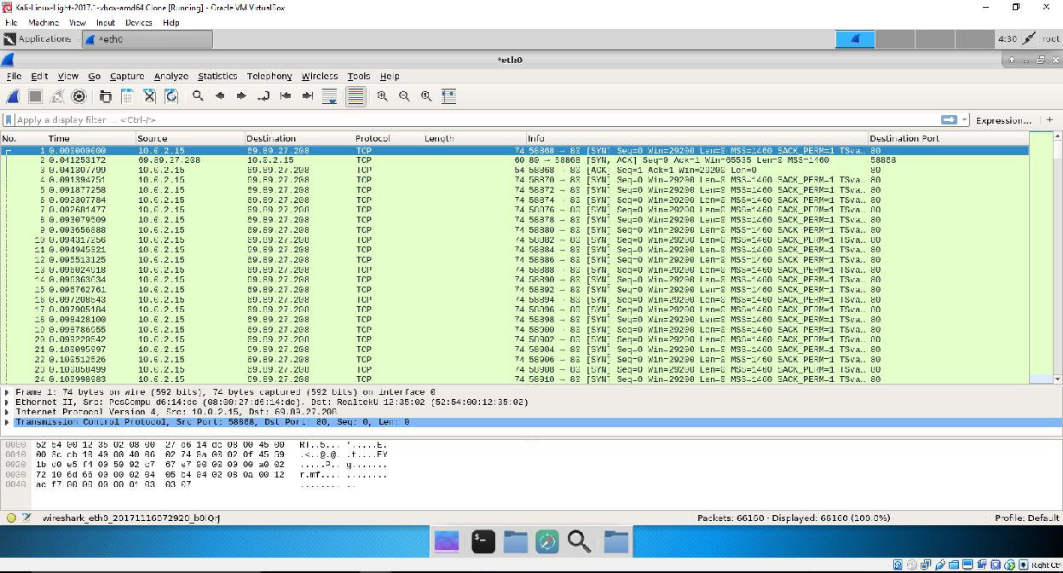
Summary of the Screenshots Below: DoS TCP SYN Flood Attack – Wireshark Capture Log File (on the cloned Kali Linux VM) Connection information (of the cloned Kali Linux VM).
(Please Zoom In)

Slide 64
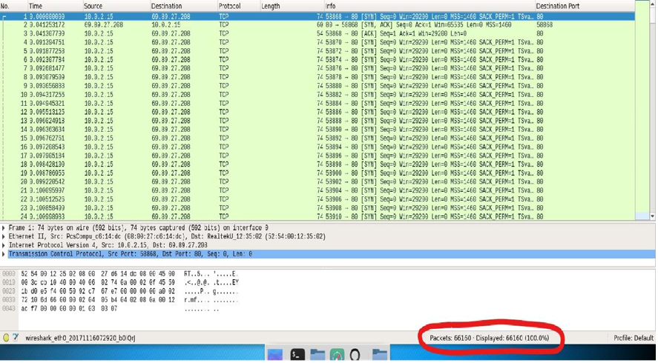

Slide 65
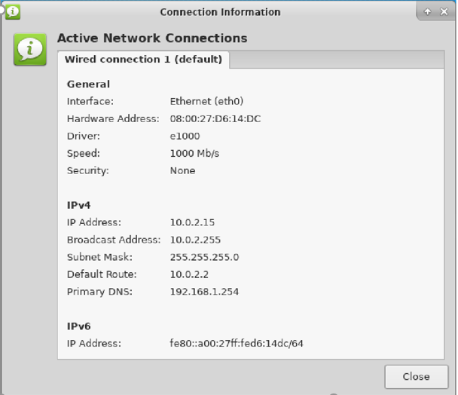

Slide 66
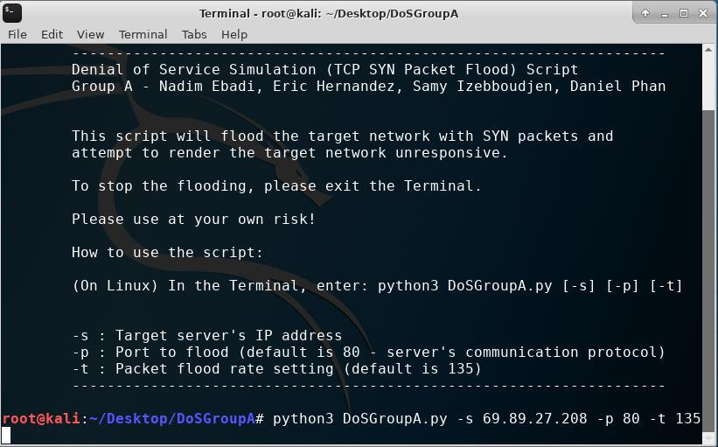
Summary of the Screenshots Below: Python DoS script being used against hackertyper.com (which, in this scenario, the website was running on the attacking VM) ^{à} Stopping the Python DoS script.

Slide 67
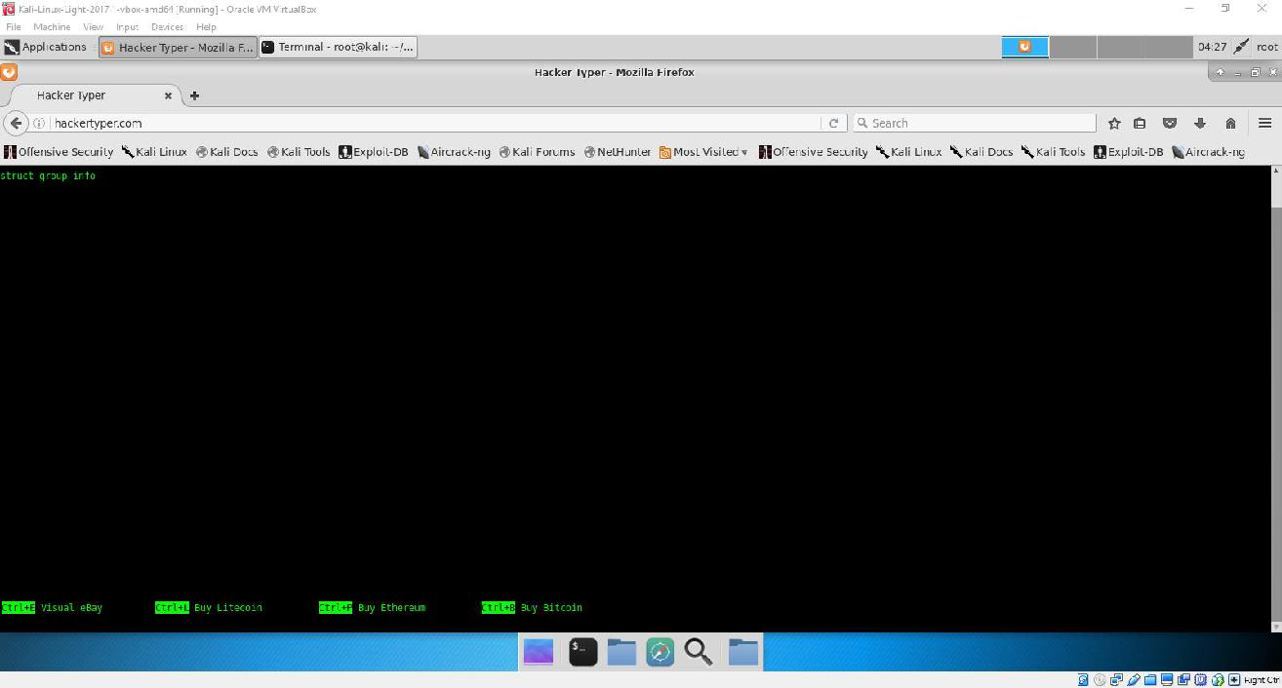
(Please Zoom In) – hackertyper.com running on the attacking Kali Linux VM:

Slide 68
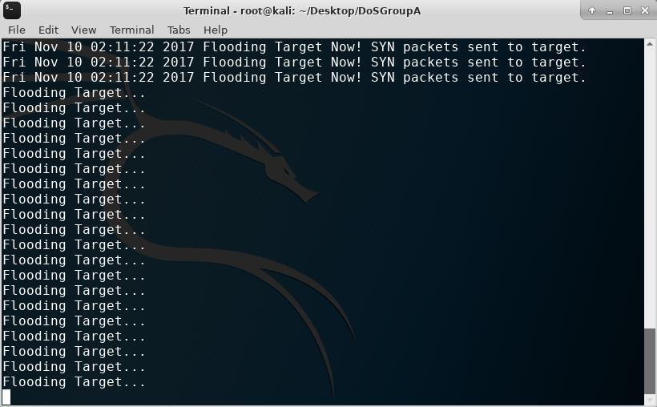

Slide 69
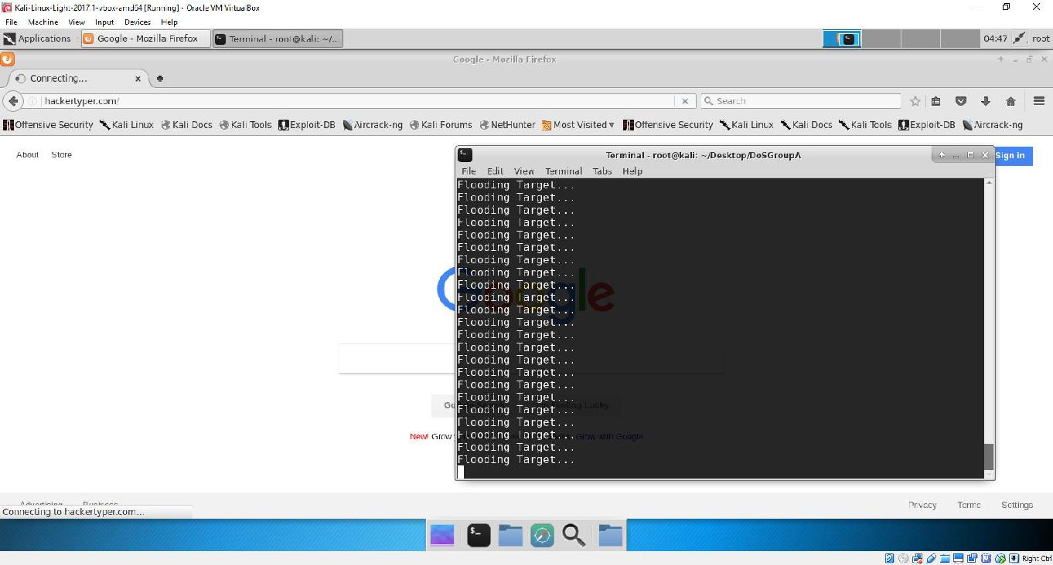

Slide 70
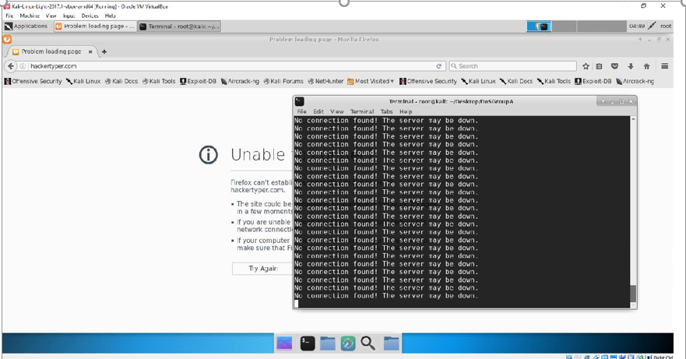

Slide 71
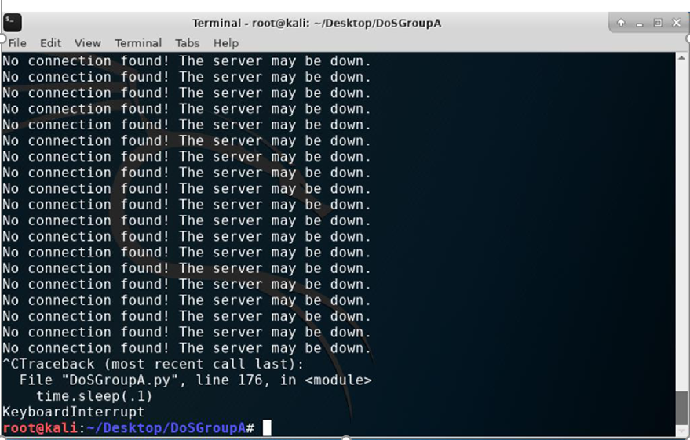

Slide 72
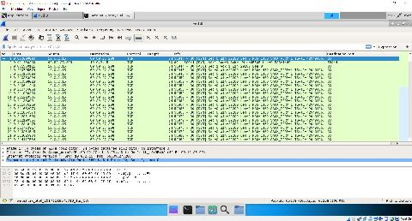
Summary of the Screenshots Below: DoS TCP SYN Flood Attack – Wireshark Capture Log File (on the attacking Kali Linux VM) Connection information (of the attacking Kali Linux
VM).
(Please Zoom In)

Slide 73
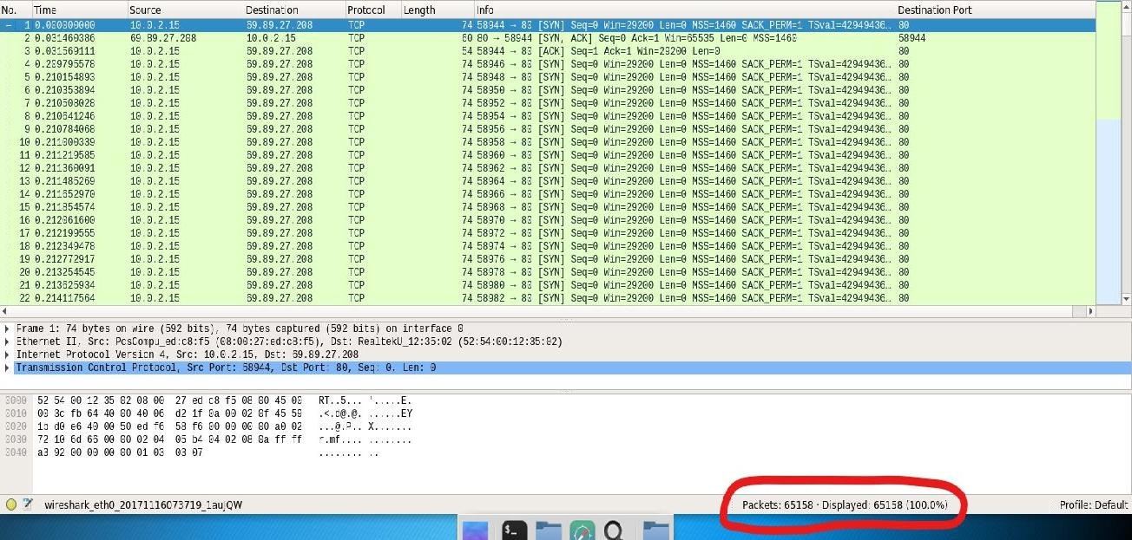

Slide 74
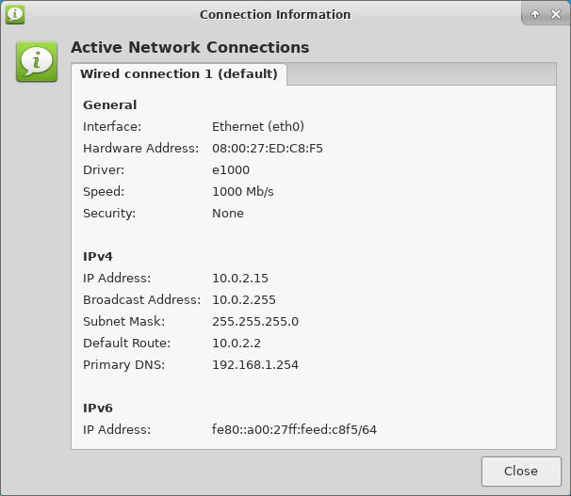

Slide 75
RESULT
With our simulated DoS attack against a targeted website/network which was run on the cloned Kali Linux virtual machine that was run on the same network (IP address) and subnet as the other Kali Linux virtual machine that was used to initiate the DoS attack with the Python DoS script (with both virtual machines being located on the attacker’s (host’s) single system), http://www.hackertyper.com was one website/network which we were able to successfully locally render unresponsive. The TCP SYN Packet Flood DoS script flooded the target website with SYN packets through the TCP protocol and port 80, which is known as the port for the server's Internet communications protocol (HTTP). After running the script, the hackertyper.com website will remain in a continuous connecting/loading state and/or the browser will send an error message saying that you are unable to connect to the website.

Slide 76
By studying DoS/DDoSattacks and through conducting our simulation, we also learned that the SYN Flood Python DoS script was mainly successful due to hackertyper.com's low level of network security. For example, from our DoS attack being successful, we found information such as hackertyper.com not having any implemented security mechanisms for blocking an IP address from sending too many packets/requests at once, meaning that the SYN packets sent from our script were allowed to be freely sent to hackertyper.com's network and thus, cause hackertyper.com's network to consume enough resources/bandwidth and render its network unresponsive. Furthermore, we also found that http://www.hackertyper.com did not have an HTTPS connection, meaning that the website/network did not have encryption techniques, such as SSL/TLS encryption, for data being exchanged between the client and server, ultimately making it easier to steal sensitive information and/or shut down the network. Lastly, our DoS attack was conducted and contained entirely inside VirtualBox on the attacker’s (host’s) own network so that no actual damage was done to http://www.hackertyper.com.

Slide 77
References:
Bryson, Richard. “Understanding Denial-of-Service Attacks.” us-cert.gov, SOC Publications, 4
Nov. 2009. Web. 14 Oct. 2017. < https://www.us-cert.gov/ncas/tips/ST04-015>.
Danniels, Mia. “Distributed Denial of Service Attacks.” incapsula.com, Imperva Publishing, 21 Aug. 2015. Web. 5 Oct. 2017. <https://www.incapsula.com/ddos/denial-of-service.html>.
Digdarshan, Kavia. “Denial of Service Attack: What it is and how to prevent it.” thewindowsclub.com, Aceloce, 31 Mar. 2017. Web. 29 Oct. 2017. <http://www.thewindowsclub.com/dos-denial-of-service-attack>.
Geiter, Charles. “DDoS Attack Scripts” incapsula.com, Imperva Publishing, 12 Jan. 2016. Web.
15 Nov. 2017. < https://www.incapsula.com/ddos/ddos-attack-scripts.html>.
Haroon, Attiq. “DDoS Attack: How to Stop DDoS.” mgeeky.com, MGeeky, 14 Jul. 2015. Web.
23 Nov. 2017. < https://mgeeky.com/denial-of-service-attack-how-to-stop-ddos>.
Lee, Timothy. “TCP SYN Flood” incapsula.com, Imperva Publishing, 19 June 2016. Web. 26
Nov. 2017. <https://www.incapsula.com/ddos/attack-glossary/syn-flood.html>.
Matthes, Eric. Python Crash Course: A Hands-On, Project-Based Introduction to Programming.1st ed. San Francisco: No Starch Press, 2015. Print

Slide 78
References:
Rouse, Margaret. “SYN Flood.” searchsecurity.techtarget.com. TechTarget, 14 Apr. 2014. Web.
3 Dec. 2017. < http://searchsecurity.techtarget.com/definition/SYN-flooding>.
Toms, Lea. “The Impact of Denial of Service Attacks.” globalsign.com, GMO, 2 Feb. 2016.
Web. 27 Oct. 2017. < https://www.globalsign.com/en/blog/denial-of-service-in-the-iot>.
Warow, Andy. “Hacker Typer.” hackertyper.com, Bluehost, 5 Jul. 2013. Web. 17 Nov. 2017.
<http://www.hackertyper.com>.
Yalcin, Can. “Python: Cyweb Hammer DoS TCP SYN Packet Flood.” github.com, GitHub, 20 May 2013. Web. 21 Nov. 2017
< https://github.com/cyweb/hammer>.
Zetter, Kim. “Hacker Lexicon: What Are DoS and DDoS Attacks?.” wired.com, Condé Nast Publications, 16 Jan. 2016. Web. 10 Oct. 2017. <https://www.wired.com/2016/01/hacker-lexicon-what-are-dos-and-ddos-attacks>.
Note: The source above was used as the base (open-source) code for the Python DoS script prototype and used as the main tool for our DoS attack simulation.

Slide 79
Project Conclusions and Solutions
Overall, through this project, we are aiming to show and describe how dangerous a targeted DoS/DDoS attack can be in today's technological world through running the open-source DoS TCP SYN Packet Flood Python script and simulating a DoS attack, using two Kali Linux virtual machines installed on VirtualBox, against a target website/network. (http://www.hackertyper.com).
DoS/DDoS attacks are the weapon of choice for cyber-hacktivist groups and are increasing in severity and complexity. This project, for demonstrating DDOS has helped us understand various attacks that takes place in real life. We have also learned that once a single system is compromised, one can easily launch an attack on the network.

Slide 80
Furthermore, we also wanted to notify the average computer user of the “unforgiving effects and consequences these attacks can have through rendering a victim's entire network unresponsive” (Geiter 7). Even though networks today have reliable security against DoS attacks, there are still new forms of DoS attacks being created to bypass network security. There are also many networks that still do not have proper security and are prone to network attacks. However, by drawing more attention to DoS/DDoS attacks, we strongly believe that the increased attention can result in a solution by making these types of network attacks decreasing in the future through the implementation of stronger security/prevention methods (as described in the “Core Concepts” section) and increased user awareness.

Slide 81
Thank You!

